Slide 1
UNIT 3
Inheritance [8hrs]
Presented by
Er. Harendra Bikram Shah
(Lecturer)
Department of BCA

Slide 2
OUTLINES
  Introduction to Inheritance
  Inheritance Relationship Diagram
  Inheritance Mode: Public, Private & Protected
  Types of Inheritance: Single, Multilevel, Hierarchical, Multiple and Hybrid
  Ambiguity Resolution
  Multipath Inheritance and Virtual Base Class
  Constructor and Destructor in Derived Class
  Subclass, Subtype and Principle of Substitutability
  Composition and its Implementation
  Composition Relationship Diagram
  Software Reusability

Slide 3
INTRODUCTION TO INHERITANCE
concept in object-oriented programming (OOP) that allows to create a new class by using the properties and behaviors of an existing class.
Inheritance establishes an "is-a" relationship between classes
The existing class is referred to as the "base class" or "parent class,“ or “Superclass” and the new class is called the "derived class" or "child class” or “Subclass”.
Syntax:
class <derived_class_name> : <access-specifier> <base_class_name> { //body }
class BaseClass
{
// Base class members
};
class DerivedClass : Public BaseClass
{
// Derived class members
};

Slide 4
ADVANTAGES and DISADVANATAGES OF INHERITANCE
Advantages of Inheritance:
Code Reusability:
Polymorphism:
Modularity and Extensibility:
Overriding:
Hierarchy and Organization:
Disadvantages of Inheritance:
Tight Coupling:
Complexity and Inheritance Depth:
Limitations:
Overuse and Misuse:
Inherited Private Members:

Slide 5
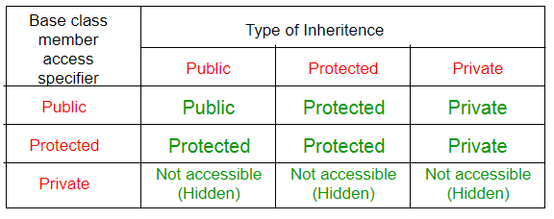
VISIBILITY MODES IN INHERITANCE

Slide 6
VISIBILITY MODES IN INHERITANCE
class A
{
public:
int x;
protected:
int y;
private:
int z;
};
class B : public A
{
// x is public
// y is protected
// z is not accessible from B
};
class C : protected A
{
// x is protected
// y is protected
// z is not accessible from C
};
class D : private A // 'private' is default for classes
{
// x is private
// y is private
// z is not accessible from D
};

Slide 7
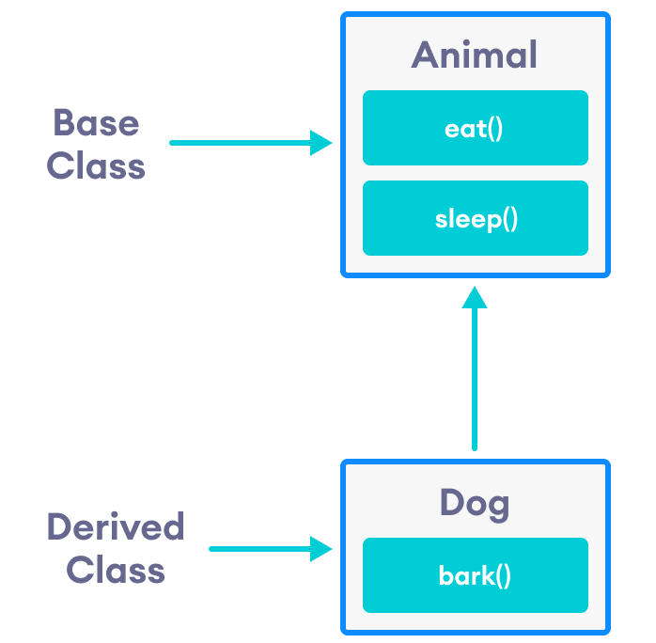
Inheritance Relationship Diagram
The inheritance relationship is characterized by the following: 1. Superclass/Base class: Also known as the parent class
2. Subclass/Derived class: Also known as the child class.
Important Note:
A derived class can inherit all base class methods except:
Constructors, destructors and copy constructors of the base class.
Overloaded operators of the base class.
The friend functions of the base class.

Slide 8
Inheritance Relationship Diagram
#include <iostream>
using namespace std; // base class class Animal { public: void eat() { cout << "I can eat!" << endl; } void sleep() { cout << "I can sleep!" << endl; } }; // derived class class Dog : public Animal { public: void dogDetails() { cout<<"I am a Husky. I am 2 Years old!"<<endl; }
void bark() { cout << "I can bark! Woof woof!!" << endl; } }; int main() { Dog husky; // Create object of the Dog class
husky.dogDetails(); // Calling members of the derived class
husky.eat(); // Calling members of the base class
husky.sleep(); // Calling members of the base class
husky.bark(); // Calling member of the derived class return 0; }

Slide 9
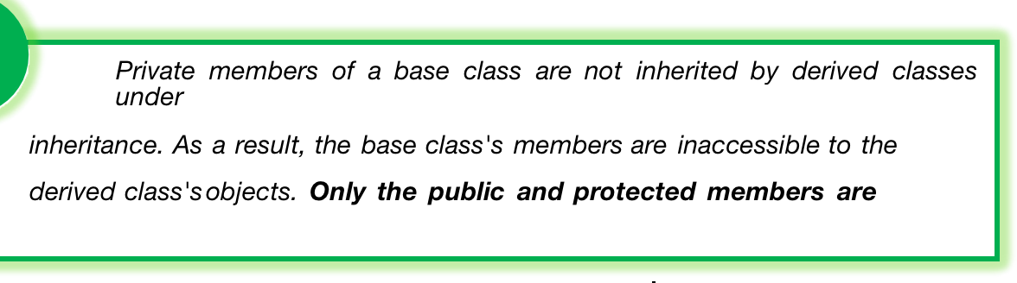
Inheritance Mode: Public, Private & Protected
In C++, the three inheritance modes are public, private, and protected.
These modes determine the accessibility of the inherited members (methods and variables) in the derived class.
1. Public Inheritance: • Syntax: class Derived : public Base
2. Private Inheritance:
•Syntax: class Derived : private Base
3. Protected Inheritance: Syntax: class Derived : protected Base

Slide 10
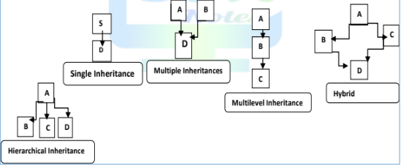
TYPES of INHERITANCE

Slide 11

Single INHERITANCE
#include <iostream>
using namespace std;
class Account
{ //base class
public:
float salary = 60000;
};
class Programmer: public Account
{ //Derived class
public:
float bonus = 5000;
};
int main(void) {
Programmer p1;
cout<<"Salary: "<<p1.salary<<endl;
cout<<"Bonus: "<<p1.bonus<<endl;
return 0;
}

Slide 12

Multilevel INHERITANCE
#include <iostream>
using namespace std;
class Account
{
public:
float salary = 60000;
};
class Bonus: public Account
{
public:
float bonus = 5000;
};
class Programmer: public Bonus
{
public:
float allowance = 8000;
};
int main() {
Programmer p1;
cout<<"Salary: "<<p1.salary<<endl;
cout<<"Bonus: "<<p1.bonus<<endl;
cout<<“Allowance: "<<p1.allowance<<endl;
return 0;
}

Slide 13
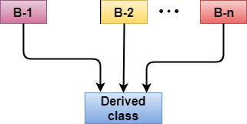
Multitype INHERITANCE
Syntax of the Derived class:
class D : visibility B-1, visibility B-2, ?
{
// Body of the class;
};

Slide 14
Multitype INHERITANCE
#include<iostream>
using namespace std;
class A
{
public:
void display()
{
cout<<"from class A"<<endl;
}
} ;
class B
{
public:
void display()
{
cout<<"From Class B"<<endl;
}
} ;
class C : public A,public B
{
public:
void display()
{
cout<<"From Class C"<<endl;
}
} ;
int main()
{
C obj;
obj.display();
obj.A::display();
obj.B::display();
return 0;
}

Slide 15
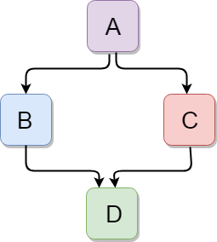
Hybrid INHERITANCE

Slide 16
Hybrid INHERITANCE
class C
{
public:
void display()
{
cout<<"From Class C"<<endl;
}
} ;
class D : public B,public C
{
public:
void display()
{
cout<<"From Class D"<<endl;
}
} ;
int main()
{
D obj;
obj.display();
obj.B::display();
obj.C::display();
return 0;
}
#include<iostream>
using namespace std;
class A
{
public:
void display()
{
cout<<"from class A"<<endl;
}
} ;
class B :public A
{
public:
void display()
{
cout<<"From Class B"<<endl;
}
} ;

Slide 17
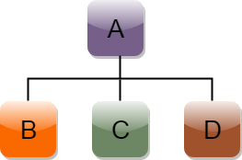
Hierarchical INHERITANCE
Syntax of Hierarchical inheritance:
class A
{
// body of the class A.
}
class B : public A
{
// body of class B.
}
class C : public A
{
// body of class C.
}
class D : public A
{
// body of class D.
}

Slide 18
Hierarchical INHERITANCE
#include<iostream>
using namespace std;
class A
{
public:
void display()
{
cout<<"from class A"<<endl;
}
} ;
class B :public A
{
public:
void display()
{
cout<<"From Class B"<<endl;
}
} ;
class C :public A
{
public:
void display()
{
cout<<"From Class C"<<endl;
}
} ;
class D : public A
{
public:
void display()
{
cout<<"From Class D"<<endl;
}
} ;
int main()
{
D obj;
obj.A::display();
C obj1;
obj1.display();
B obj2;
obj2.display();
return 0;
}

Slide 19
Ambiguity Problem in INHERITANCE
In multiple inheritances, when one class is derived from two or more base classes then there may be a possibility that the base classes have functions with the same name, and the derived class may not have functions with that name as those of its base classes.
#include<iostream>
using namespace std;
// Base class A
class A {
public:
void func() {
cout << " I am in class A" << endl;
}
};
// Base class B
class B {
public:
void func() {
cout << " I am in class B" << endl;
}
};
// Derived class C
class C: public A, public B {
};
// Driver Code
int main() {
// Created an object of class C
C obj;
// Calling function func()
obj.func();
return 0;
}

Slide 20
Solution to Ambiguity Problem in INHERITANCE
To solve this ambiguity scope resolution operator is used denoted by ‘ :: ‘
Syntax:
ObjectName.ClassName::FunctionName();
// Driver Code
int main() {
// Created an object of class C
C obj;
// Calling function func() in class A
obj.A::func();
// Calling function func() in class B
obj.B::func();
return 0;
}
#include<iostream>
using namespace std;
// Base class A
class A {
public:
void func() {
cout << " I am in class A" << endl;
}};
// Base class B
class B {
public:
void func() {
cout << " I am in class B" << endl;
}
};
// Derived class C
class C: public A, public B {
};

Slide 21
Constructor and Destructor in Derived Class
Constructors in a derived class in C++ are important for several reasons:
Initialization of Base Class Members:
Calling Base Class Constructors:
Setting Default Values:
Code Clarity and Readability:
Syntax:
Derived-Constructor (arg1, arg2, arg3….): Base 1-Constructor (arg1,arg2), Base 2-Constructor(arg3,arg4)
{
….
} Base 1-Constructor (arg1,arg2)

Slide 22
#include<iostream>
using namespace std;
class A
{
public:
A(int x)
{
cout<<"a Constructor";
}
};
class B
{
public:
B(int y)
{
cout<<"b Constructor";
}
};
class C:public A,public B
{
public:
int m;
C(int x,int y,int z):A(x),B(y)
{
cout<<"c Constructor";
m=z;
}
void disp()
{
cout<<"the m is:"<<m<<endl;
}
};
int main()
{
C obj (1,2,3);
obj.disp();
return 0;
}

Slide 23
Destructors in Derived Class: • The destructor of the derived class is called before the destructor of the base class when an object is destroyed. • You don't need to explicitly call the base class destructor since it's automatically invoked. • You can define your own destructor in the derived class to perform additional cleanup specific to the derived class.
Example:
#include<iostream> using namespace std; class Base { public: Base() { cout << "Base constructor called" << endl; } ~Base() { cout << "Base destructor called" << endl; } }; class Derived : public Base { public: Derived() {
cout << "Derived constructor called" << endl;
} ~Derived() { cout << "Derived destructor called" << endl; } }; int main() { Derived derivedObj;
return 0; }

Slide 24
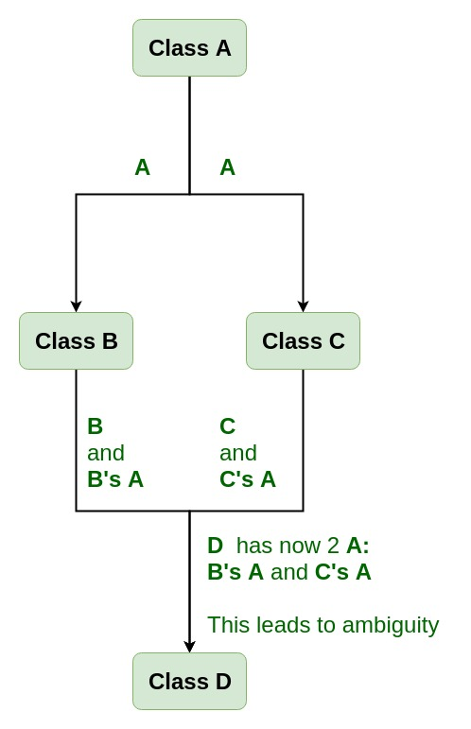
Virtual Class

Slide 25
Virtual Class
#include <iostream>
using namespace std;
class A {
public:
void show()
{
cout << "Hello form A \n";
}
};
class B : public A {
};
class C : public A {
};
class D : public B, public C {
};
int main()
{
D object;
object.show();
}
Compile Errors:

Slide 26
Solution to this Problem is Virtual Class
To resolve this ambiguity when class A is inherited in both class B and class C, it is declared as virtual base class by placing a keyword virtual as :
Syntax for Virtual Base Classes:
Syntax 1: class B : virtual public A { };
Syntax 2: class C : public virtual A { };
#include <iostream>
using namespace std;
class A {
public:
int a;
A() // constructor
{
a = 10;
}
};
class B : public virtual A {
};
class C : public virtual A {
};
class D : public B, public C {
};
int main()
{
D object; // object creation of class d
cout << "a = " << object.a << endl;
return 0;
}

Slide 27
Subclass, Subtype and Principle of Substitutability
Subclass:
In C++, a subclass refers to a class that is derived from another class, known as the base class or superclass.
Subtype:
In C++, a subtype refers to a type that is derived from another type, just like a subclass is derived from a base class.
The subtype inherits the characteristics of the supertype and can be used wherever the supertype is expected.
Principle of Substitutability:
The principle of substitutability, also known as the Liskov substitution principle, is a fundamental principle of object-oriented programming. It states that objects of a derived class (subtype) must be able to be substituted for objects of the base class (supertype) without affecting the correctness of the program.

Slide 28
Composition and its Implementation
Composition is one of the fundamental approaches or concepts used in object-oriented programming (OOP) that allows you to create complex objects by combining simpler objects.
It is a way to establish relationships between classes, where one class contains an instance of another class as a member variable.
Composition in C++ is achieved by using objects and classes; therefore, it is referred to as object composition.
The object composition concept work on the model of has-a relationship among two different objects.
In object composition, the object created is a part of another object which is referred to as a sub-object and the whole object is called super-object.
A Sub-object is destroyed when an object composition is destroyed, known as a do and die relationship.
• Composition is all about code reuse. • Composition is a specialized form of aggregation. • Creating objects of one class inside another class. • “Has a” relationship o Bird has a beak. o Employee has a date of birth. • Child object does not have their lifecycle and if parent object deletes all child object will also be deleted.

Slide 29

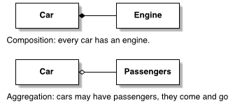

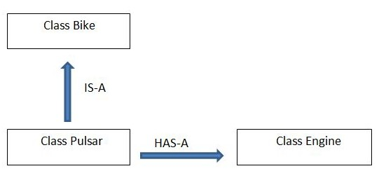

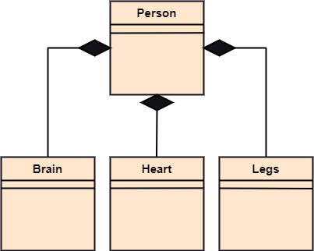

Composition and its Implementation
Person is a whole object.
Brain, Heart, and Legs are part object.
This whole part relationship is composition.

Slide 30
Composition and its Implementation
#include<iostream> using namespace std; class Engine { Output:
#include<iostream>
using namespace std;
class Engine
{
public:
void start()
{
cout<<"Engine starts"<<endl;
}
};
class Car
{
public:
Engine e; //class Engine object as a member variable of class Car
string brand;
string color;
void showDetails()
{
cout<<"Brand : "<<brand<<endl; cout<<"Color : "<<color<<endl;
e.start();
}
};
int main()
{
Car c;
c.brand = "Lamborghini";
c.color = "Blue";
c.showDetails();
return 0;
}
Output
Brand : Lamborghini
Color : Blue
Engine starts

Slide 31
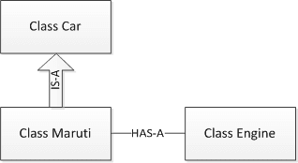
Composition Relationship Diagram
#include<iostream> using namespace std; class Engine { Output:
Composition relationship is also called a part-whole or whole-part relationship in which the part component can only be a part of a single object simultaneously.
In composition relationships, the part component will be created when the object is created, and the part will be destroyed when the object is destroyed.
Composition (HAS-A) simply mean the use of instance variables that are references to other objects. For example, Maruti has Engine, or House has Bathroom.

Slide 32


Software Reusability
#include<iostream> using namespace std; class Engine { Output:
Software reusability is an important concept in software development that aims to maximize the reuse of existing code components in order to improve productivity, maintainability, and reduce development time and costs.
In C++, there are several mechanisms and practices that promote software reusability. Classes: Inheritance: Templates:
Note
Example: Show the simple inheritance program which shows the code reusable

Slide 33
Function Overriding
#include <iostream>
using namespace std;
class Parent {
public:
void disp()
{
cout << "Base Function" << endl;
}
};
class Child : public Parent {
public:
void disp()
{
cout << "Derived Function" << endl;
Parent::disp();//another method for calling overriden function
}
};
int main()
{
Child obj;
obj.disp();
obj.Parent::disp();
Parent *ptr=&obj;
ptr->disp();//another method using pointer to call overriden function
return 0;
}

Slide 34
END of THE UNIT 3

